Slide 1

HERC air emissions and impact on health
Notes:
Waste management decision (whether or not to operate HERC) based on a risk management goal – Do emissions from HERC create an unacceptable health risk to people and is that risk disproportionately distributed more (higher risk) to people of color. Will shutting down HERC have a positive health impact in communities near HERC?
When you see articles and opinions on HERC closing, the focus is typically on emissions – “HERC emits A, B, C pounds or tons of X, Y, Z – whether it be lead, mercury, nitrogen oxides, particulate matter, dioxin. These pollutants are linked to asthma, heart disease, increased risk of death from COVID.” You may also see a focus on health impacts in a nearby community – incidence of asthma, for example – being tied to HERC emissions.
How do you make a more direct correlation between emissions from HERC and the potential for health impacts? Particularly if HERC is not the only source of emissions in the area.
Focused question, not looking at issues of climate change, odor, traffic, cost of managing waste, impacts of alternative approaches to managing the waste.

Slide 2

Evaluating the impact of HERC air emissions on our health
Conclusions:
The cancer and non-cancer risks from HERC emissions by themselves are well below Minnesota Department of Health incremental risk thresholds
Emissions from mobile and non–point sources pose much higher risks to human health than emissions from HERC
HERC is not likely to cause more harmful cancer or non-
cancer health effects in one part of the community than another (similarly low impact on surrounding communities)
Notes:
The findings conclude that the cancer and non-cancer risks from HERC emissions by themselves are well below Minnesota Department of Health incremental risk thresholds. This result makes sense since as a permitted point-source facility, HERC is not allowed to emit pollutants in amounts that would increase cancer or non-cancer risks above incremental risk thresholds. MPCA would not issue a permit to HERC if they had data that said they did. This is why MPCA requires permits for point sources – to require the emissions controls to avoid an adverse health impact
The overall emissions in Hennepin County are dominated by mobile and non-point sources, which makes those sources more likely to have greater impacts on the total risk in the area. Our results only looked at HERC specific contributions, not all point source contributions to the total risk, however, the MPCA’s Understanding Environmental Justice in Minnesota website has it broken out by source type and in most census tracts, the primary source of the total risk is traffic emissions.
The overall impact from HERC’s emissions was negligible by itself, and especially when compared with the current background cancer and non-cancer levels.
HERC is not likely to cause more adverse cancer or non-cancer health effects in one population than in others (similar and low impact to all populations)

Slide 3
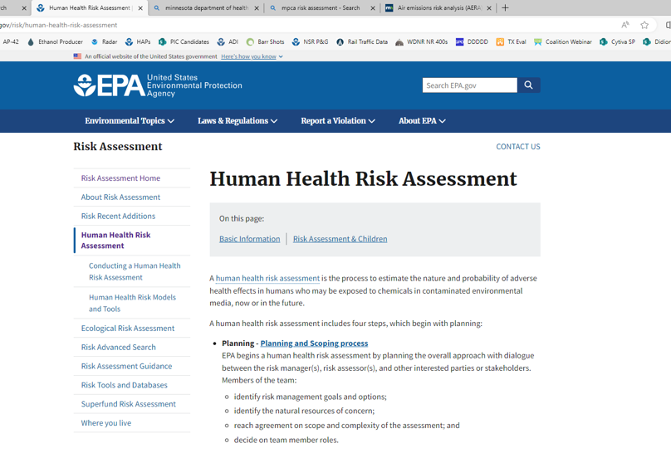
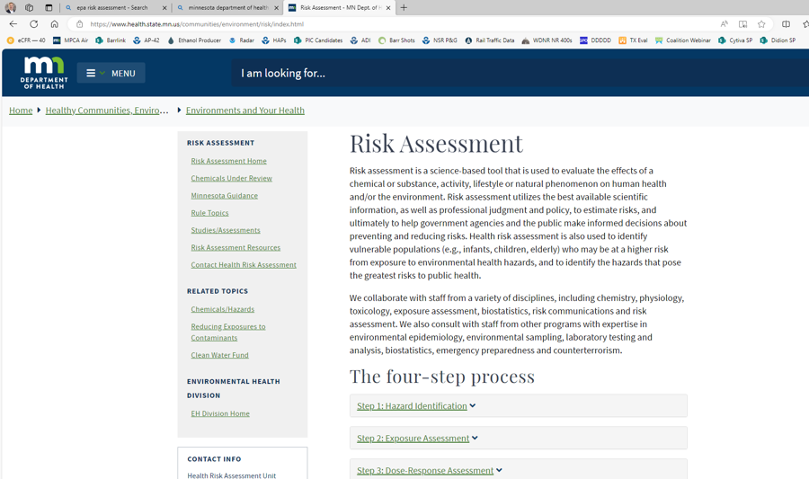
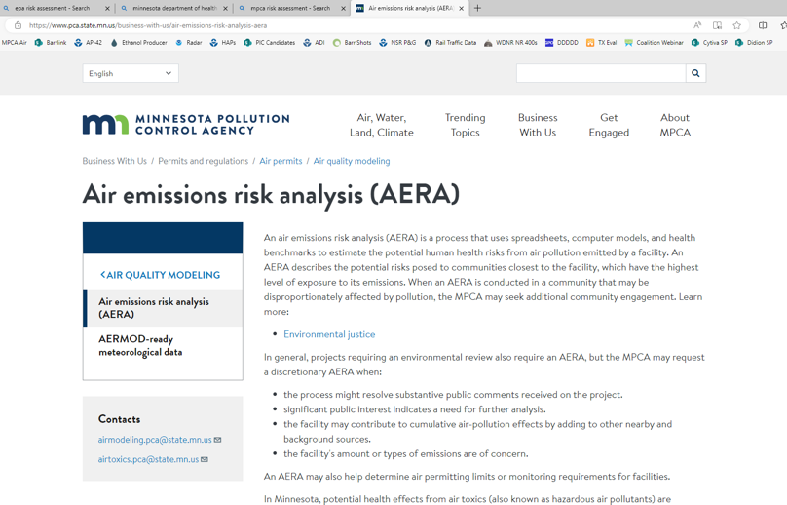
U.S. EPA defines risk as the “chance of harmful effects to human health or to ecological systems”
Risk assessment estimates people’s increased risk of health problems as a result of breathing or ingesting a pollutant
Notes:
How do we evaluate whether air emissions have an unacceptable risk? The Environmental Protection Agency (EPA), Minnesota Pollution Control Agency (MPCA) and Minnesota Department of Health (MDH) use the science of “risk assessment” to characterize the nature and extent of potential health impacts to humans due to chemical contaminants in the environment (air, water, soil).
Emissions are a component of the risk assessment. But not all of it because health impact is a complex function of how much pollutant you are exposed to, and what level of exposure results in health effects.

Slide 4
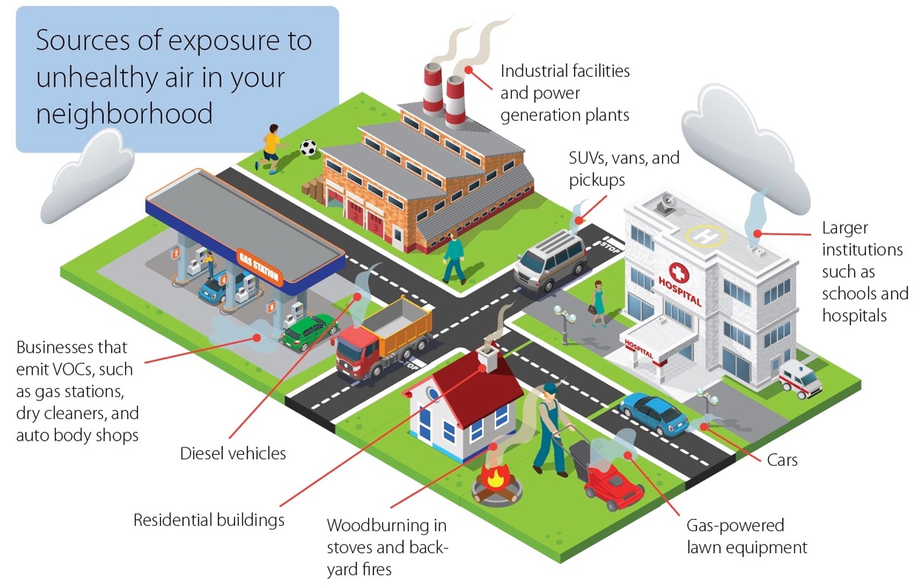
Emissions come from “sources”
www.pca.state.mn.us/air/neighborhood-sources
Notes:
This figure comes from the Minnesota Pollution Control Agency’s (MPCA’s) website. And it shows that there are a variety of emission sources in our neighborhoods.
There can be a variety of specific pollutants that come from each source. You can see that they often have an outlet point – a smokestack, a chimney, a tailpipe. But not always – like in the case of a backyard fire.
Emissions are typically measured on a mass per time basis – short-term as pounds per hour, grams per second, longer-term as tons per year or pounds per year.
They’re grouped into three main categories, 1) point sources, 2) non point sources, and 3) mobile sources.
Point source facilities with air quality permits issued by the Minnesota Pollution Control Agency. Most regulated of all source types (require
air pollution controls; testing and monitoring; recordkeeping and reporting) HERC is a point source. In total, point sources produce less pollution than the next two types of sources.
Non-point, Facilities too small to require a permit - by “too small” we mean not high enough emissions from any one facility, but there are a lot of them and collectively they produce a high amount of emissions.
Examples: gas stations, dry cleaners, asphalt paving, and industrial, commercial, and residential burning of fuel Includes your home furnace, water heater and stove if they use natural gas. Also includes indoor fireplaces and outdoor fire pits, whether they burn natural gas or wood.
Mobile sources include on-road and off-road which are not individually regulated. Examples include passenger cars and trucks, commercial trucks and buses, aircraft, heavy equipment, marine vessels, recreational vehicles, small engines and tools (gas-powered lawnmowers. Collectively mobile sources produce a high proportion of emissions.

Slide 5
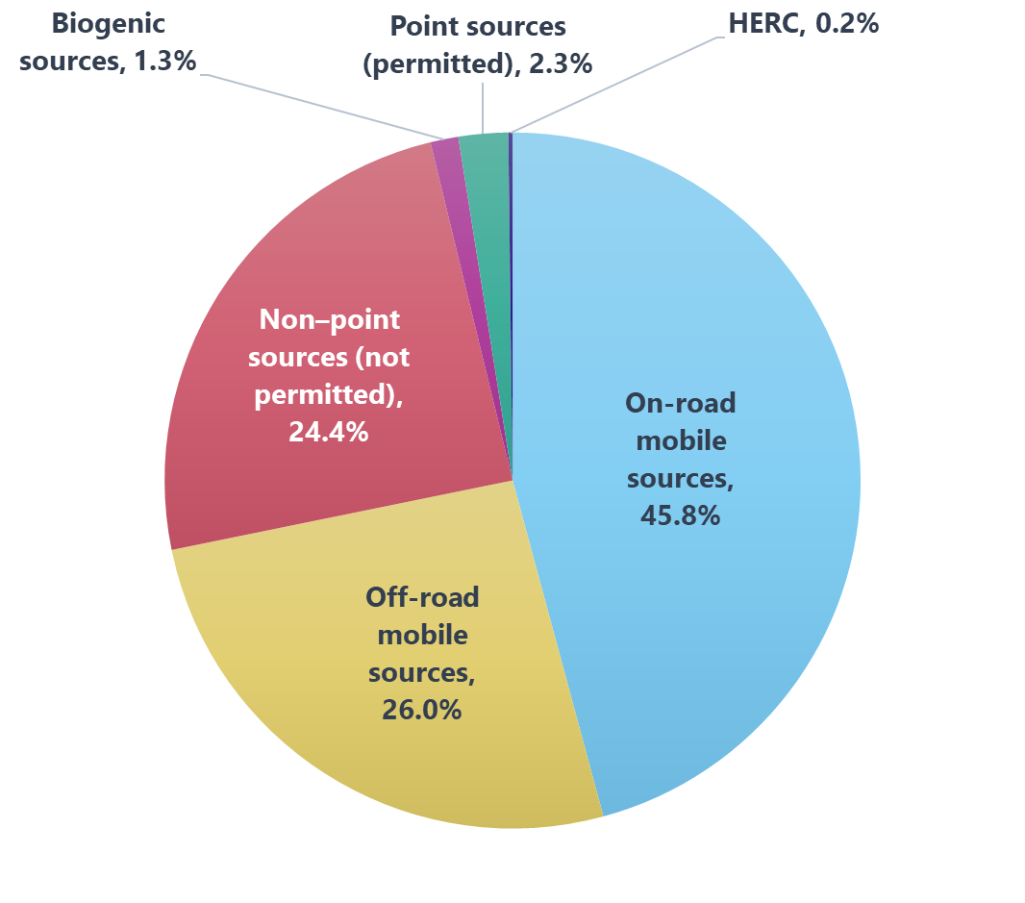
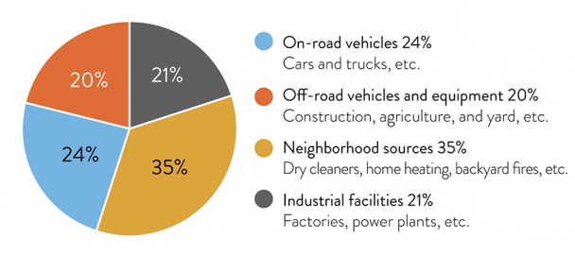
Minnesota and Hennepin County emissions by source
Emission-source percentages for entire state
Percentages for Hennepin County
www.pca.state.mn.us/air/sources-air-pollution
www.pca.state.mn.us/air/statewide-and-county-air-emissions
Notes:
Data comes from two MPCA websites, but it’s all based on emission inventory data.
The graph on the left, statewide, 79% of emissions are from sources other than point sources. In an urban/suburban area, even where you are likely to have a higher density of point sources, total emissions are driven by the roads and traffic density, population, and commercial emitters. In Hennepin County the percent (% )from point sources from all point sources is 2.3%, HERC’s portion is only 0.2%.
The contribution of HERCs emissions compared to total emissions is quite small, which is also true pollutant by pollutant.
Also note that point sources typically have tall “smoke stacks”, so the release points for emissions are high in the air, which increases dispersion of those pollutants. Emissions from mobile sources and many of the non-point sources are low to the ground, and in the breathing zone.

Slide 6
The four steps of risk assessment
Hazard identification
What health problems are caused by the pollutant?
Dose-response assessment
What are the health problems
at different exposures?
Risk characterization
What is the extra risk of
health problems in people
who were exposed?
Exposure assessment
How much of the pollutant
are people exposed to in a specific time period? How
many people are exposed?
www.epa.gov/risk/conducting-human-health-risk-assessment
Notes:
A risk assessment can be summarized in four steps. First, determine which pollutants can cause health impacts. Next, determine the minimum amount of the pollutant that causes a measurable health impact along with the length of time a person is exposed to the pollutant that results in a measurable health impact. With this information, the pollutant is assigned a risk value which is used in combination with the air concentration to quantify the potential health risk, either cancer or non-cancer.
Risk is dependent on a given exposure and how much of the pollutant people are exposed to which influences the resulting types of health problems. There are 4 steps that go into characterizing a total risk for a population. The first is identifying a specific pollutant’s potential health impacts or hazards. Once that is determined, scientific and clinical studies are conducted to identify the dose-response of that pollutant, or the amount of a pollutant that is hazardous to human health. Additionally, an exposure assessment identifies the length of time that is considered hazardous to human health for a given pollutant. Using all of this information, a risk characterization of the pollutant is quantified as a risk value to compare to a pollutant’s air concentration.
Risk is summed across pollutants and across exposure “scenarios”.

Slide 7
Risk
Cancer risk: The probability that a person will develop
cancer over their lifetime as a result of long-term exposure
to carcinogenic chemicals
Non-cancer risk: The highest level of exposure to a chemical that should cause no harmful non-cancer effects
Notes:
Risk assessments look at two different types of risk, cancer risk and non-cancer risk. Examples of non-cancer health ailments are asthma, or heart or kidney disease. Cancer risk represents the increased chance a person has of developing cancer over their entire lifetime. Non-cancer risk represents the level below which a person “should” experience no harmful effects. Some pollutants have cancer effects, some have non-cancer effects, some have both.

Slide 8
Incremental risk guidelines
Calculated risk results are compared to the following facility risk guidelines developed by the Minnesota Department of Health, in accordance with U.S. EPA guidance
Total facility cancer risk below or at:
1 in 100,000 (1 x 10⁻⁵)
Total facility hazard index below or at: 1
Notes:
State and federal regulatory standards and guidelines are intended to limit exposures to potential carcinogens from regulated facilities to very low risks, for example, one additional cancer diagnosis in 100,000 people with lifetime exposure. This level of cancer risk is purposefully many thousands of times lower than cancer risks that can be detected by epidemiologic studies or examination of community cancer rates.

Slide 9
MNRisks
Minnesota Statewide Screening of Human Health Risks from Air Pollution
Air toxics risk-screening tool
Modeling: air concentrations, soil, surface water
Last updated in 2014
Accounts for point sources, non–point sources, and mobile sources
Notes:
The data that we will be referencing for the risk results is the direct output from the Minnesota Statewide Screening of Human Health Risks from Air Pollution Modeling, or MNRisks. It is a statewide model incorporating all emission sources (point, non-point, and mobile) and uses an emission inventory database of actual emissions from 2014. The modeling looked at receptors throughout the entire state and calculated air concentrations for exposures from both breathing in the air pollution and from other pathways like ingestion of plants, fish, and meat from exposure in soil and waterbodies. MNRisks is scheduled to be updated with a more recent emission inventory to evaluate how our potential risks have changed.
“Minnesota Risk Screening” MPCA’s tool for evaluating risks in Minnesota resulting for a variety of pollutant sources
Soil and surface water concentrations are used in the Agricultural and Fish Consumption Exposures

Slide 10
MNRisks
Calculates risks for specific receptors
Assesses potential risks by individual health endpoints (e.g., cancer, non-cancer chronic)
Estimates of source and pollutant culpability
Compares model-estimated air concentrations to monitored concentrations
Provides for source-category comparisons
(point-source vs. traffic contributions)
Assesses environmental equity by incorporating demographic data
Notes:
MNRisks is a statewide modeling evaluation which assesses both cancer and non-cancer risks across the entire state. The model output provided by MPCA allowed us to identify specific point source contributions to a modeled receptor risk along with determining which pollutants were the largest contributors to a total risk. The results can be viewed as an “Air Pollution Score” on MPCA’s Environmental Justice tool. We used MPCA’s underlying risk calculations to look at HERC contributions in comparison to other air pollution sources.
Now that we’ve explained the important concepts of emissions, air quality, and risk, what does the data tell us about HERC’s impacts.
Define “receptor” as discussed
“Culpability” – which sources and pollutants “drive” the overall risk (like, how much of the blame or responsibility falls on a source or pollutant)

Slide 11
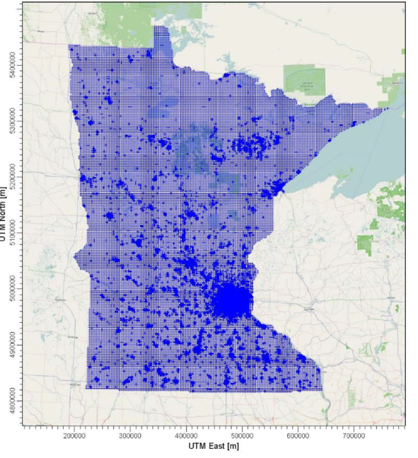
MNRisks modeled receptor locations
Notes:
The large image shows the MNRisks receptor grid superimposed on the environmental justice map, with HERC identified as a yellow star. The state map on the left shows the full MNRisks receptor grid for the entire state. Using the emissions data and dispersion factors, the model calculates the pollutant concentrations at each receptor location (purple dot). Statewide, there are about 65,000 receptors and the grid spacing is smaller in the metro area with greater population density and larger in greater Minnesota where the population density is much smaller. The air concentration outputs provided the highest 1-hour average air concentration, and the maximum annual average air concentration.
a. 3,000-meter spacing across the entire state
b. 300-meter spacing in the Metro area
c. At each Block group centroid (4,111 receptors)
d. A 300-meter diameter ring around point sources in the emissions inventory
e. Property boundaries for major facilities that have submitted model data information

Slide 12
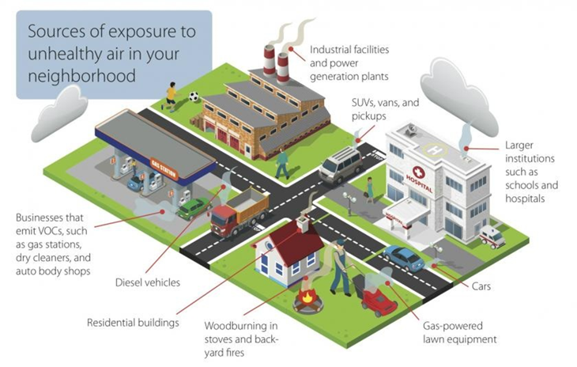
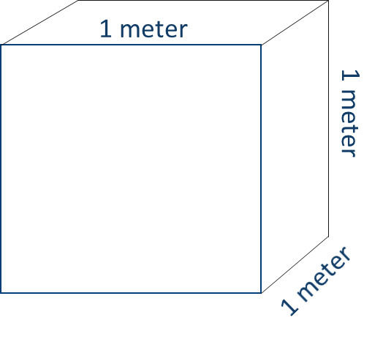
Model output for each receptor
Source 1, Pollutant a
Source 1, Pollutant b
:
Source 1, Pollutant n
Source 2, Pollutant a
Source 2, Pollutant b
:
Source 2, Pollutant n
:
Source n, Pollutant a
Source n, Pollutant b
…
(ug/m3)
Notes:
At each receptor location (purple dot) in the previous slide, the model calculates the highest one-hour and annual average air concentration of each pollutant from all source’s combined emissions. Each point (permitted) source has its own contribution, while non-point (area) and mobile sources contribute collectively in general areas which means we aren’t able to identify a specific mobile source or non-point source’s contribution to an air concentration. The purple circle represents a single receptor which represents an air concentration as a mass of a pollutant within a cubic meter. That pollution (ug) represents the sum of all source’s emissions of each pollutant. Then, each pollutant’s air concentration is compared to their cancer or non-cancer health risk guideline value and then all pollutants with a cancer health risk value are add together to get a total cancer risk at each receptor. The same goes for all pollutants with non-cancer health risk values, they are added together for a total non-cancer risk at each receptor.
You sum each pollutant across all sources to determine the total pollutant at that location. You can determine each source’s contribution to a total pollutant concentration at that location.
MNRisks also looks at what portion of the emissions is deposited to soil and water. These are used in the agricultural and fish-consumption scenarios.
Risk is calculated for a receptor by looking at the contribution of all pollutants (total from all sources) across all pathways. Because we have pollutant contributions by source, we can also determine a particular sources contribution to risk as a fraction of overall risk at that location.

Slide 13
Relative health impacts from HERC’s emissions
Risk is calculated for a receptor by looking at the contribution of all pollutants (total from all sources) across all pathways.
Use the analysis of pollutant contributions by source to determine a particular source's contribution to risk as a fraction of overall risk at a specific location.
Identified census tracks surrounding the HERC facility to understand HERC’s contribution to total risk at these locations.
Notes:
You sum each pollutant across all sources to determine the total pollutant at that location. You can determine each source’s contribution to a total pollutant concentration at that location.
MNRisks also looks at what portion of the emissions is deposited to soil and water. These are used in the agricultural and fish-consumption scenarios.
Risk is calculated for a receptor by looking at the contribution of all pollutants (total from all sources) across all pathways. Because we have pollutant contributions by source, we can also determine a particular sources contribution to risk as a fraction of overall risk at that location.

Slide 14
Reference tracts for following figures
Notes:
The risk results we will be presenting show HERC’s contribution to the total relative cancer and non-cancer risk for a series of census tracts outlined in this figure. The tracts were selected by extending out six radial directions at different distances to get a general mix of EJ and non-EJ designated areas. The risk from HERC’s contribution is based on the average concentration from receptors within the tract. The risk from all sources is based on the average risk across all blocks within a tract. So, the average across all the purple dots within each of these black outlined areas represents the risk within the census tract.

Slide 15
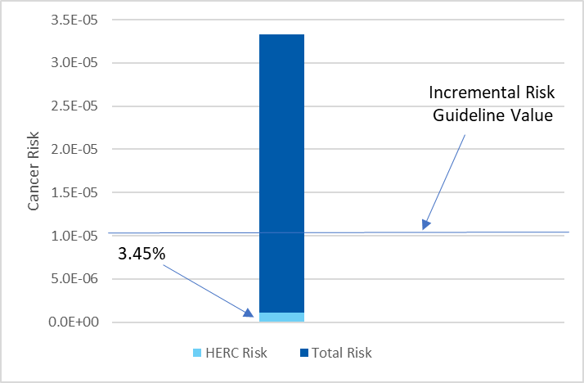
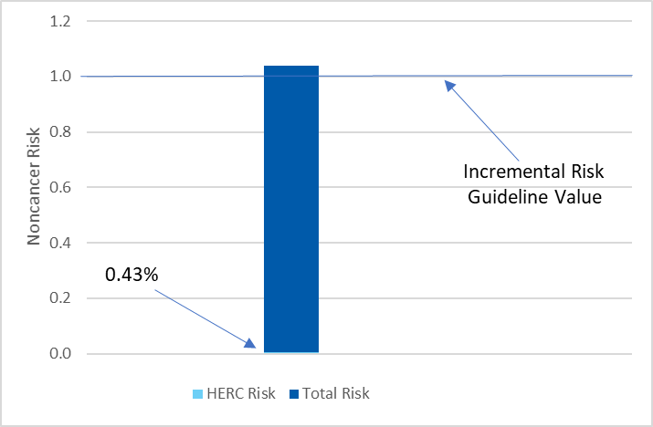
Result of risk analysis by census tract
1262 – North Loop
Cancer Risk
Noncancer Risk
Note: % represents HERC contribution as a fraction of Total Risk
Notes:
We will start with the North Loop census tract which is the area directly surrounding HERC. These graphs compare HERC’s contribution (red) to total risk (blue) as a percentage of total risk. The total risk is associated with all other sources (other point sources, non-point sources, mobile sources). The left graph shows the cancer risk and the right graph shows the non-cancer risk. Both charts identify the incremental risk guideline value as a blue line. The total cancer risk is approximately 3.25X10-5 or 3.3 people in 100,000 which is 3 times over the incremental risk guideline level. HERC’s emissions make up 3.45% of that estimate. For non-cancer, the total risk is slightly above 1 and HERC’s emissions make up 0.43% of that total.
In a hypothetical case of HERC shutting down, removing the light blue bar of HERC’s contributions would not resolve the remaining cancer or non-cancer risk. As we review the other census tract results, you will see this pattern repeated.
Emission graphs showed about 83,000 lb of HCL per year, and 0.003 lb of dioxin. Dioxin is the primary driver of cancer risk, non-cancer risk from HCL and dioxin are on a similar scale and the majority of the risk driver

Slide 16
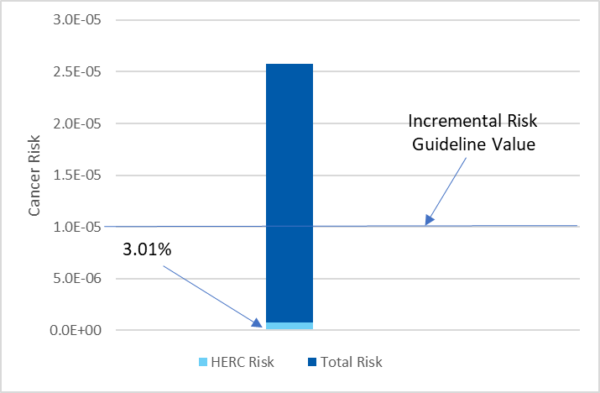
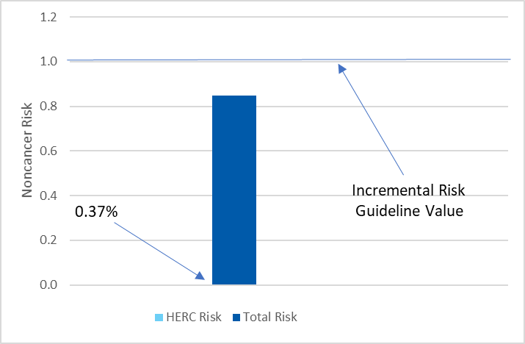
Result of risk analysis by census tract
1034 – Sumner Glenwood
Cancer Risk
Noncancer Risk
Note: % represents HERC contribution as a fraction of Total Risk

Slide 17
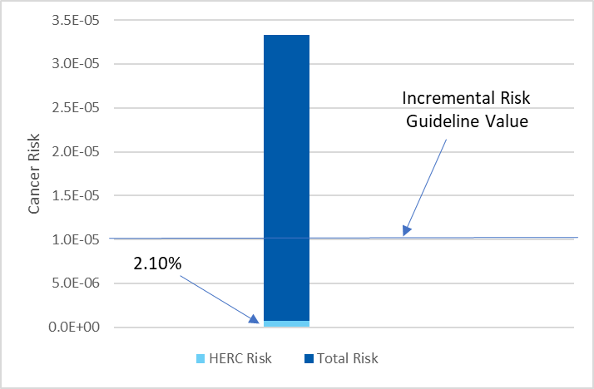
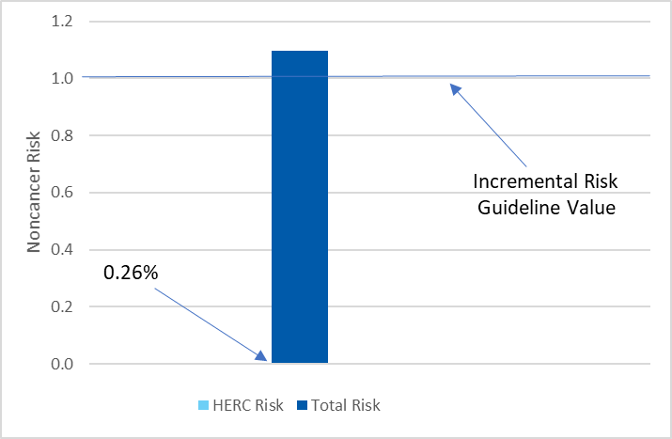
Result of risk analysis by census tract
1036 – St. Anthony West/Nicollet Island-East Bank
Cancer Risk
Noncancer Risk
Note: % represents HERC contribution as a fraction of Total Risk

Slide 18
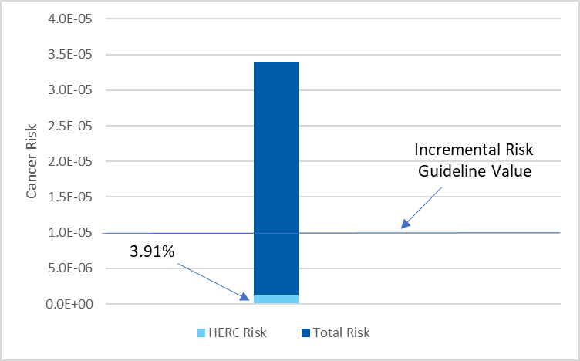

Result of risk analysis by census tract
1261 – Downtown West/East
Cancer Risk
Noncancer Risk
Note: % represents HERC contribution as a fraction of Total Risk

Slide 19
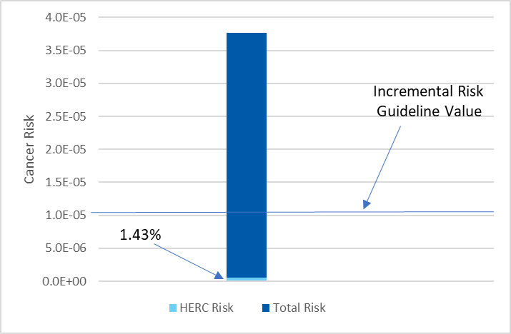
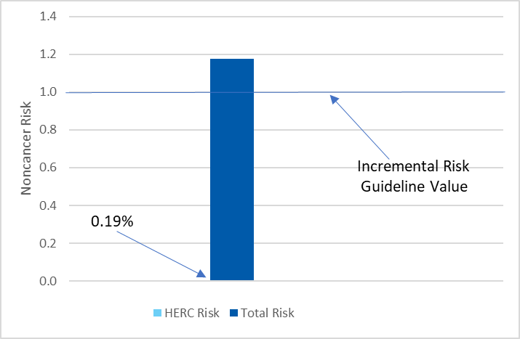
Result of risk analysis by census tract
1052.01 – Loring Park
Cancer Risk
Noncancer Risk
Note: % represents HERC contribution as a fraction of Total Risk

Slide 20
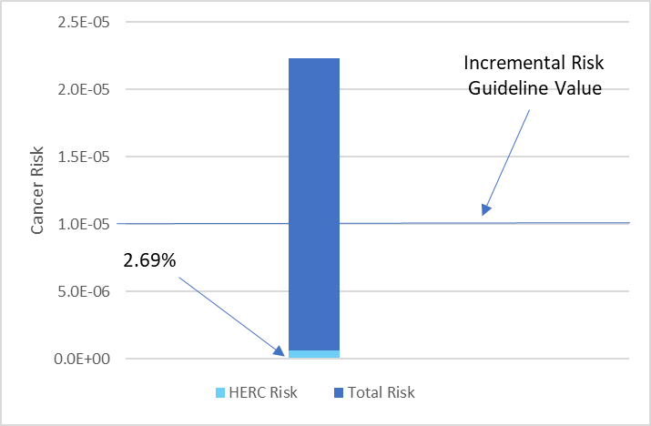
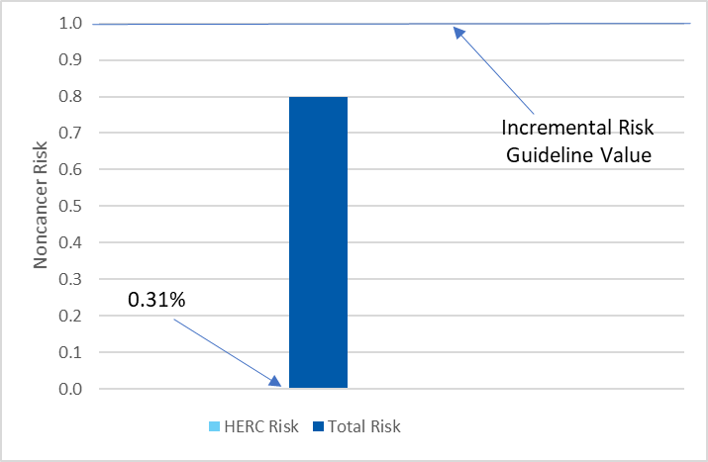
Result of risk analysis by census tract
1028 – Near North/Willard-Hay
Cancer Risk
Noncancer Risk
Note: % represents HERC contribution as a fraction of Total Risk

Slide 21
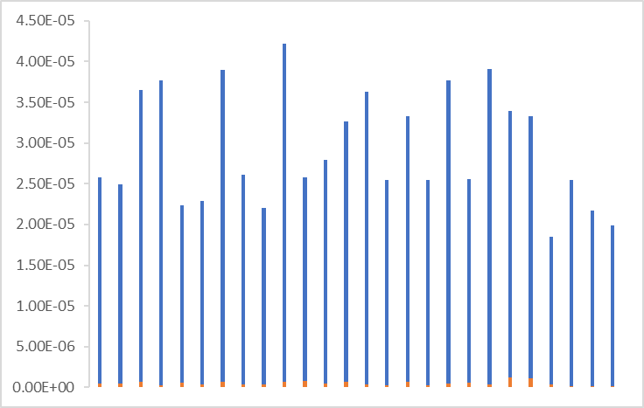
Total cancer risk comparison of EJ and non-EJ designated tracts
EJ
Non-EJ
Incremental Risk Guideline Value
Notes:
This chart summarizes the total cancer risk from all census tracts and groups them by EJ tract vs non-EJ tract in no particular order. Once again HERC’s portion of the total is in red at the bottom. Average total risk value is higher in EJ than in non-EJ areas.

Slide 22
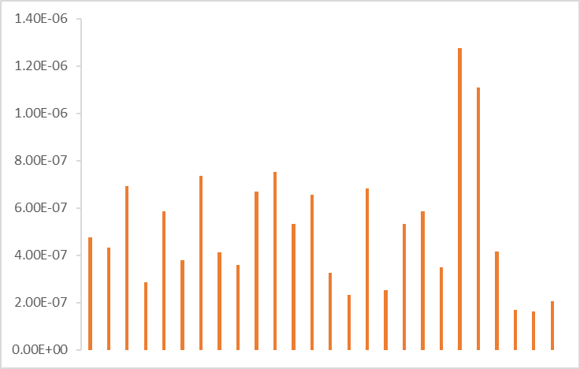
HERC cancer risk comparison of EJ and non-EJ designated tracts
EJ
Non-EJ
Notes:
We pulled out the red contribution from HERC in the previous chart to look at the cancer risk solely from HERC. The maximum scale on the vertical axis 1.4E-06 or 1.4 person in 1,000,000 people, which is below the incremental cancer risk guideline level.

Slide 23
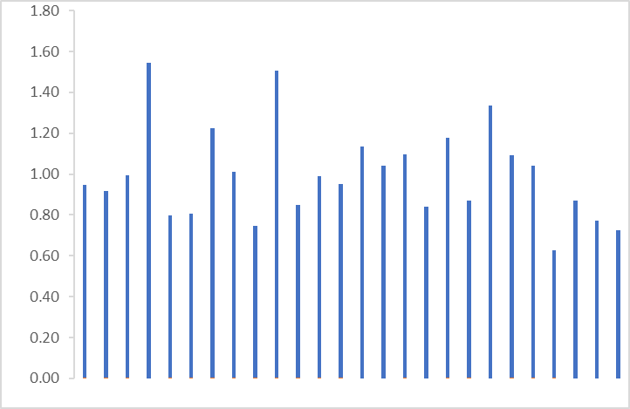
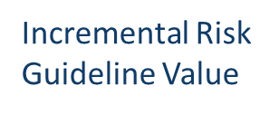
Total noncancer risk comparison of EJ and non-EJ designated tracts
EJ
Non-EJ
Notes:
This chart summarizes the total noncancer risk from all census tracts and groups them by EJ tract vs non-EJ tract in no particular order. Once again HERC’s portion of the total is in red at the bottom. There are 5 EJ census tracts above the incremental risk guideline value compared to 6 non-EJ census tracts.

Slide 24
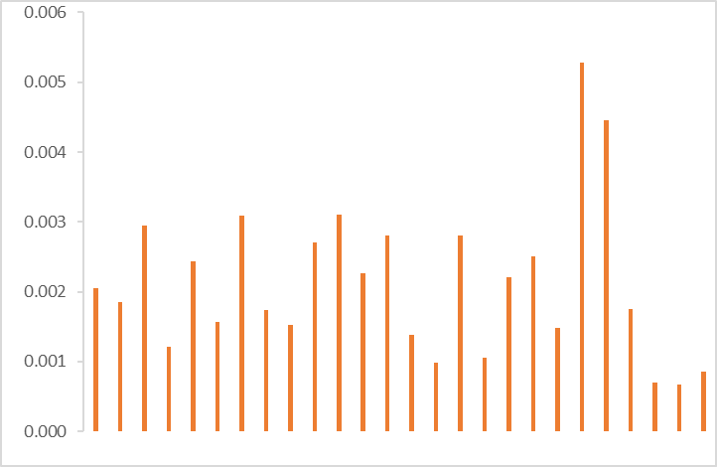
HERC noncancer risk comparison of EJ and non-EJ designated tracts
EJ
Non-EJ
Notes:
We pulled out the red contribution from HERC in the previous chart to look at the noncancer risk solely from HERC. The maximum scale on the vertical axis 0.006, which is well below the incremental noncancer risk guideline level of 1.

Slide 25
Conclusions
The cancer and non-cancer risks from HERC emissions by themselves are well below Minnesota Department of Health incremental risk thresholds
Emissions from mobile and non–point sources pose much higher risks to human health than emissions from HERC
HERC is not likely to cause more harmful cancer or non-
cancer health effects in one part of the community than another
(equally low impact on surrounding communities)
Notes:
To summarize our findings, from a risk perspective The cancer and non-cancer risks from HERC emissions by themselves are well below Minnesota Department of Health incremental risk thresholds. This result makes sense since as a permitted point-source facility, HERC is not allowed to emit pollutants in amounts that would increase cancer or non-cancer risks above incremental risk thresholds. MPCA would not issue a permit to HERC if they had data that said they did. This is why MPCA requires permits for point sources – to require the emissions controls to avoid an adverse health impact.
The overall emissions in Hennepin County are dominated by mobile and non-point sources, which makes those sources more likely to have greater impacts on the total risk in the area. Our results only looked at HERC specific contributions, not all point source contributions to the total risk, however, the MPCA’s Understanding Environmental Justice in Minnesota website has it broken out by source type and in most census tracts, the primary source of the total risk is traffic emissions.
The overall impact from HERC’s emissions was negligible by itself, and especially when compared with the current background cancer and non-cancer levels.
When looking at MnRISK, HERC is not likely to cause more adverse cancer or non-cancer health effects in one population than in others (similar and low impact to all populations)

Slide 26
References
MDH. 2018. Brief Update on Cancer Occurrence in East Metro Communities. https://www.health.state.mn.us/data/mcrs/docs/rpteastmetro.pdf
Minneapolis Health Department. 2016. Air Quality in Minneapolis: A Neighborhood Approach – Executive Summary. Minneapolis Health Department. https://www2.minneapolismn.gov/media/content-assets/www2-documents/government/Air-Quality-Study-Executive-Summary.pdf
MPCA. 2003. Air Toxics Monitoring in the Twin Cities Metropolitan Area. Preliminary Report. https://www.pca.state.mn.us/sites/default/files/lr-airtoxmonitoring-1sy03.pdf
MPCA. 2003. Personal exposure to PM_{2.5} in Minneapolis-St. Paul. https://www.pca.state.mn.us/sites/default/files/environmentalbulletin-0803.pdf
MPCA. 2016. 2013-2015 Community Air Monitoring Project Final Report. https://www.pca.state.mn.us/sites/default/files/aq8-35.pdf
MPCA. 2017. MNRISKS: Minnesota Statewide Screening of Human Health Risks from Air Pollution. https://www.pca.state.mn.us/sites/default/files/aq9-29.pdf
MPCA. 2021. 2022 Annual Air Monitoring Network Plan for Minnesota. https://www.pca.state.mn.us/sites/default/files/aq10-20a.pdf
MPCA. Neighborhood Sources.www.pca.state.mn.us/air/neighborhood-sources
MPCA. Sources of air pollution. www.pca.state.mn.us/air/sources-air-pollution
USEPA. 2016. Technical Guidance for Assessing Environmental Justice in Regulatory Analysis.
https://www.epa.gov/sites/default/files/2016-06/documents/ejtg_5_6_16_v5.1.pdf
USEPA. 2021. Conducting a Human Health Risk. www.epa.gov/risk/conducting-human-health-risk-assessment

